Slide 1
WASTE MANAGEMENT & AREA UTILIZATION IMPROVEMENT
HUBLI IT PARK
Conversion of Garbage Dumping Area into Sitting & Parking Space
A Initiative by Security Team

Slide 2
ISSUE IDENTIFIED:
The area was previously filled with garbage waste and unusable. It was causing unhygienic conditions and unpleasant smell.
ACTION TAKEN:
The garbage pile was completely cleaned and removed by with the help of Housekeeping Team. A separate designated place was made for waste dumping.
The cleaned area was levelled and converted for useful purpose.
RESULT:
Now the area is clean and properly utilized for:- Sitting arrangement for people- Car parking facility
The work was completed by our security team with the support of housekeeping team, improving cleanliness and overall premises utilization.

Slide 3
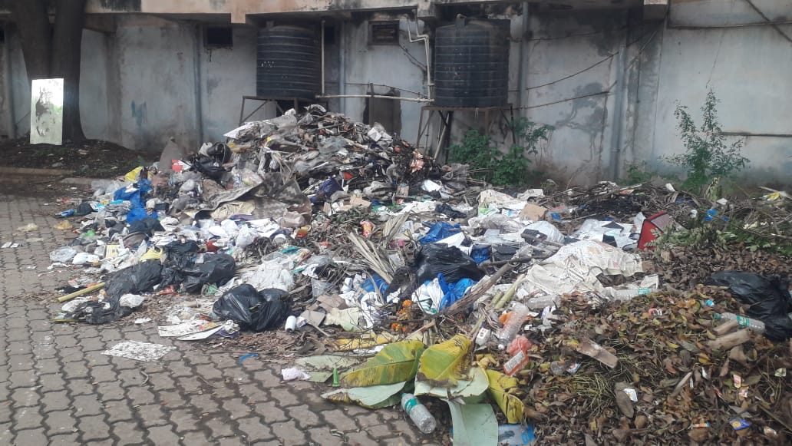
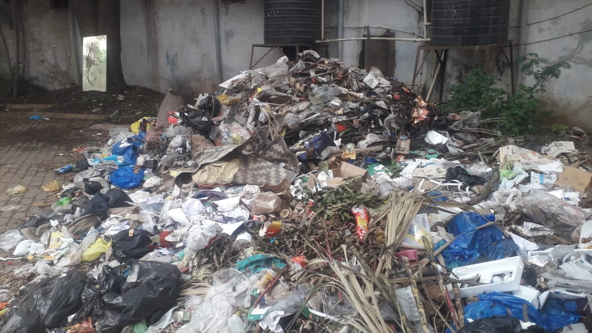
BEFORE PHOTO

Slide 4
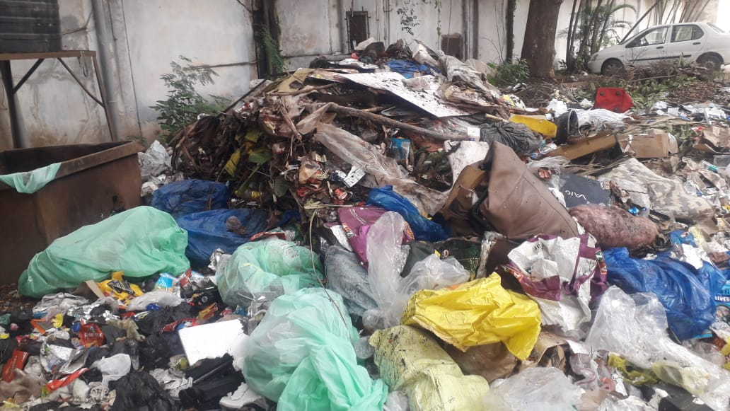
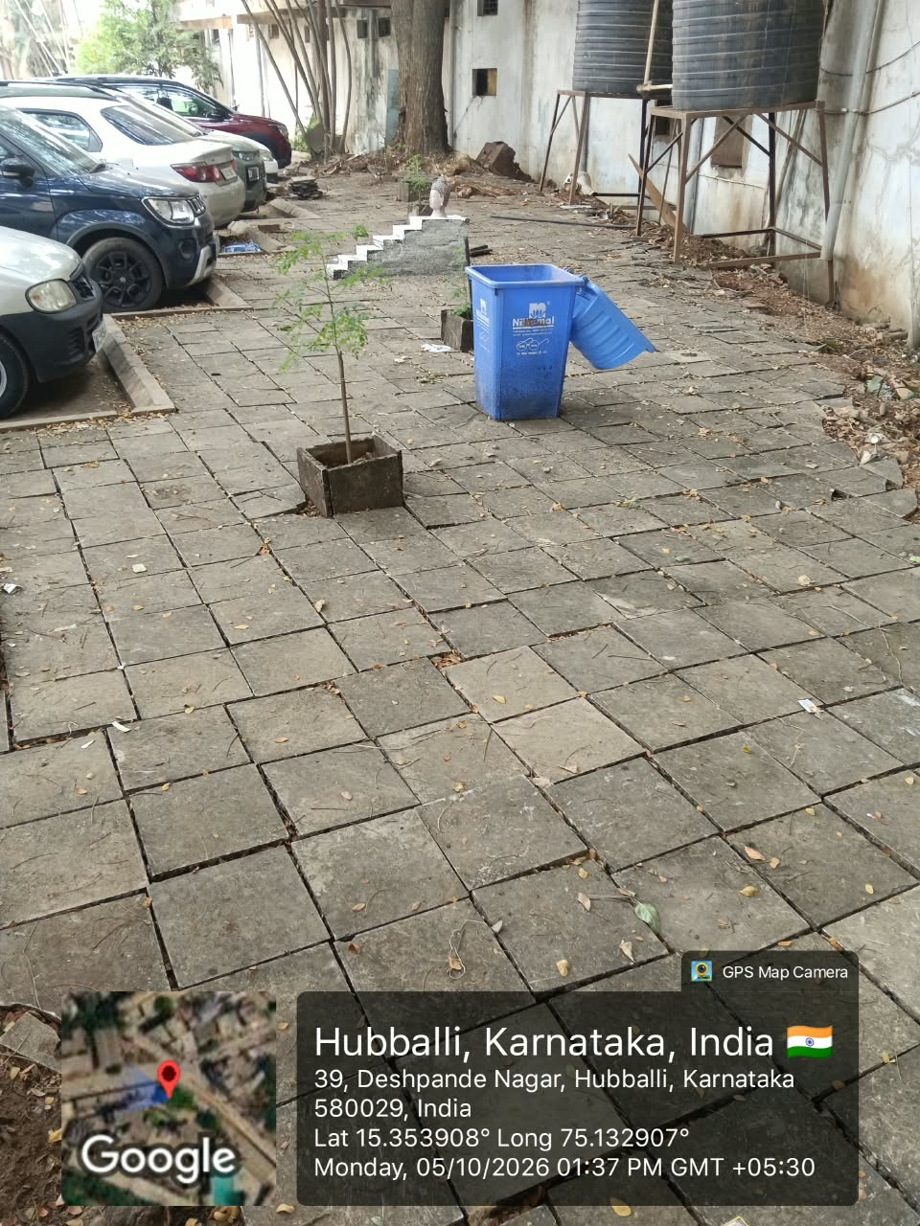
BEFORE PHOTO
AFTER PHOTO

Slide 5
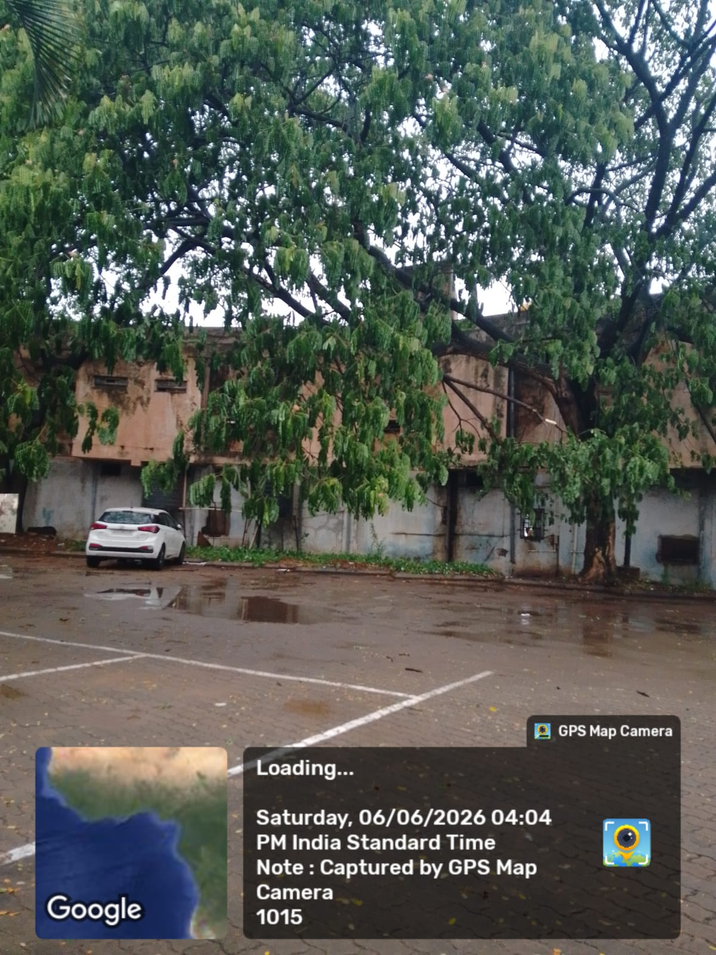
BEFORE: Garbage dumped area, AFTER: Cleaned and utilized for Car Parking

Slide 6
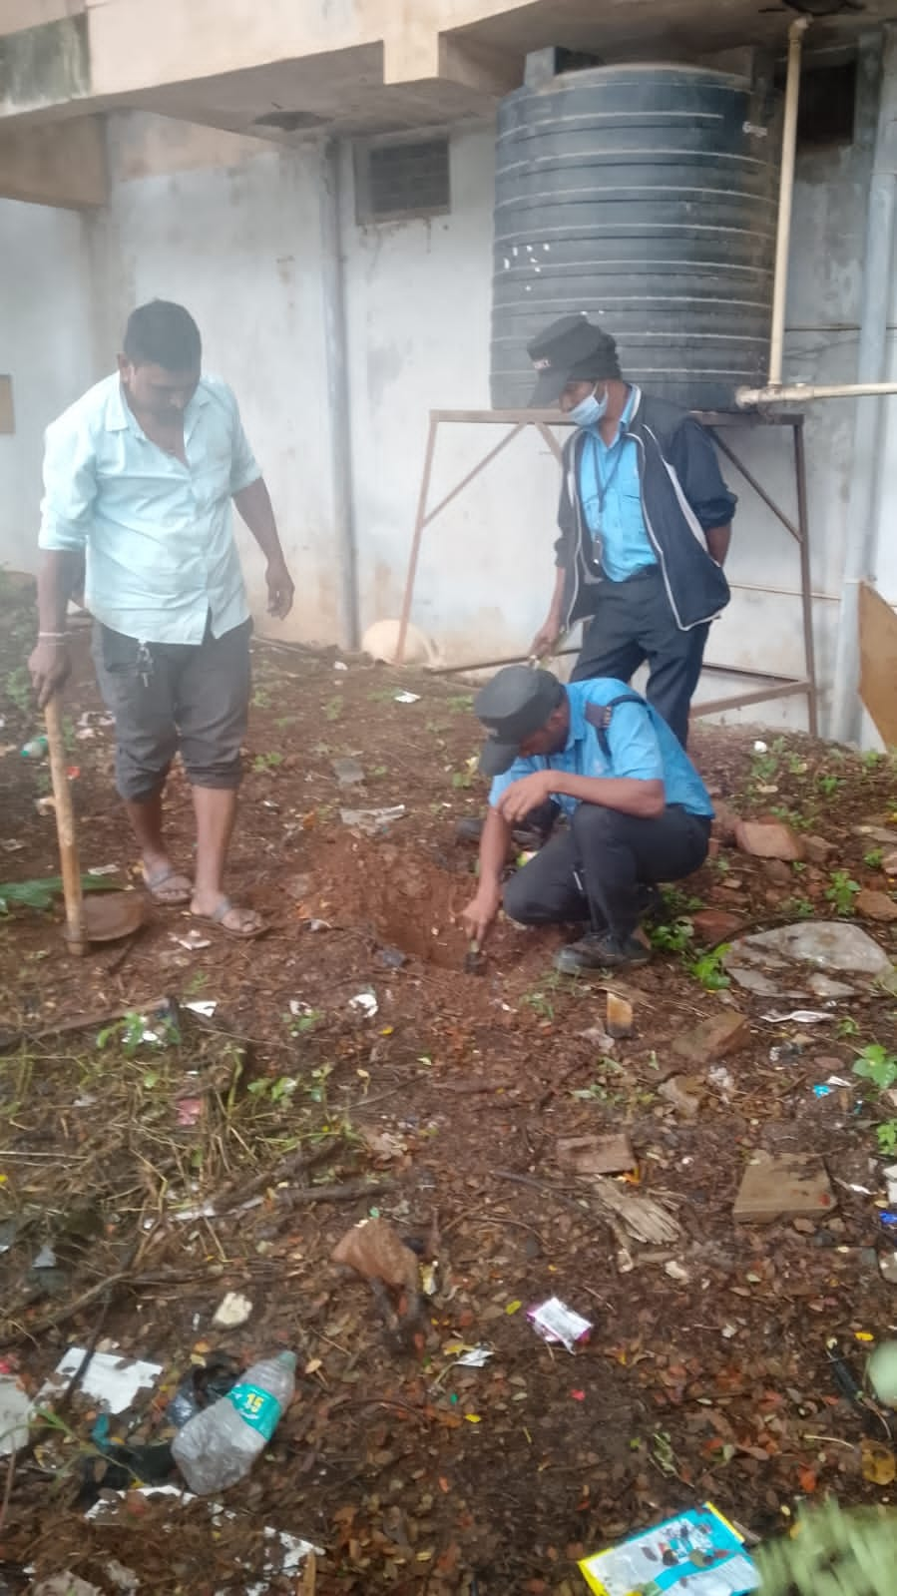
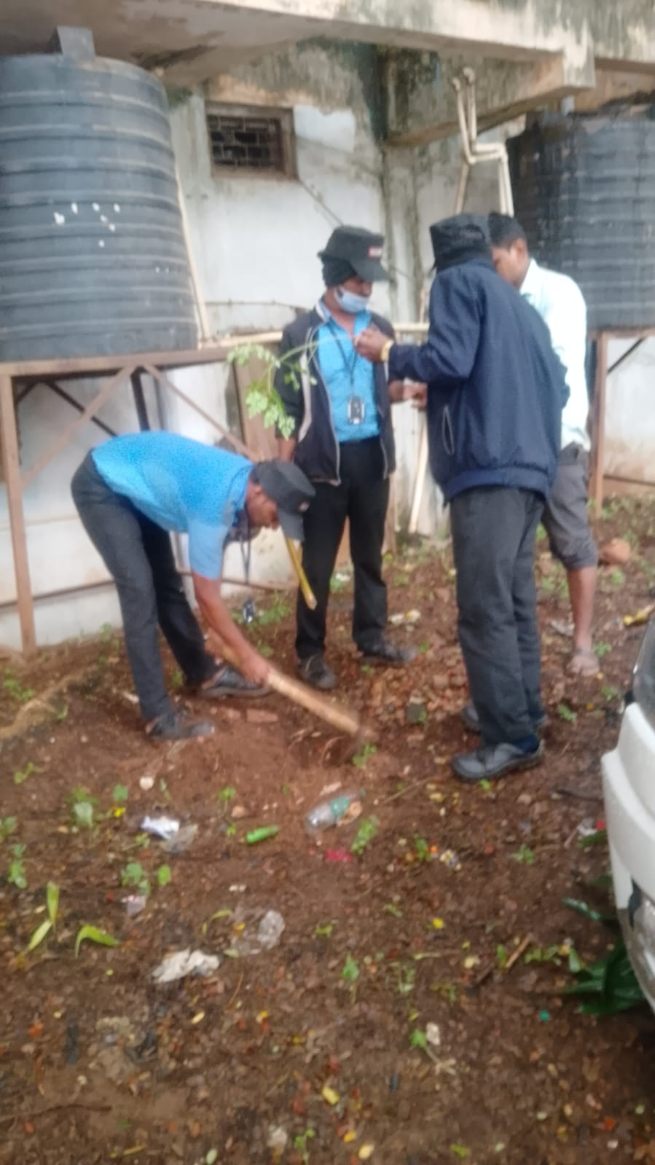
The garbage pile was completely cleaned and removed by Security Team with the help of Housekeeping Team. A separate designated place was made for waste dumping. The cleaned area was levelled and converted for useful purpose.

Slide 7
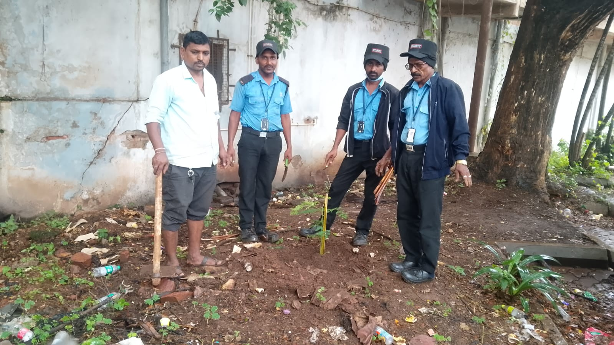
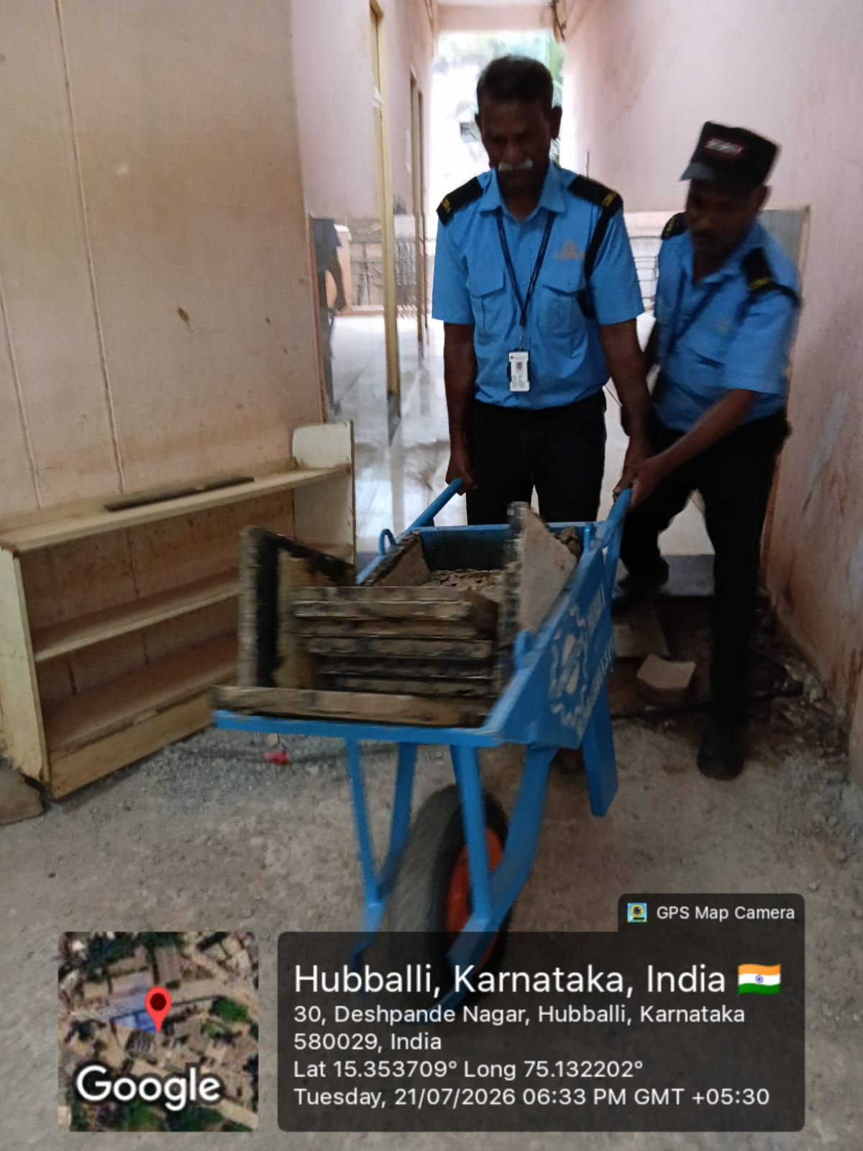
Utilization of Waste Tiles for Area Improvement
Reusing 5000+ Waste Tiles Lying on Terrace
Premises Cleaning Activity in Progress

Slide 8
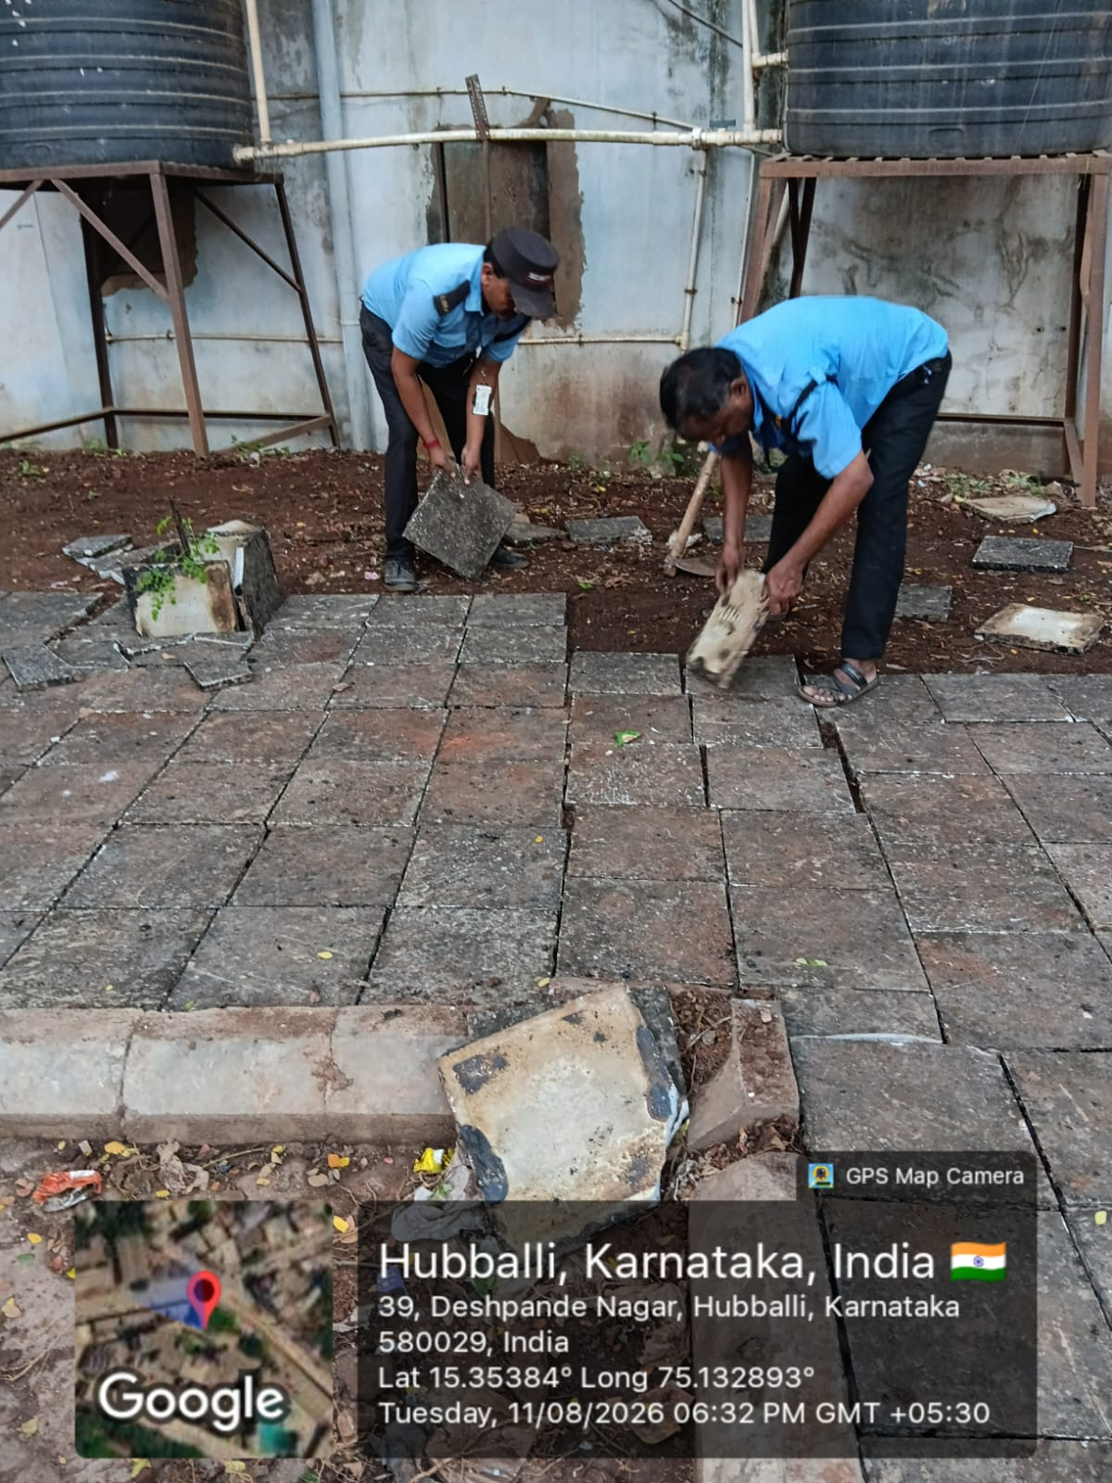
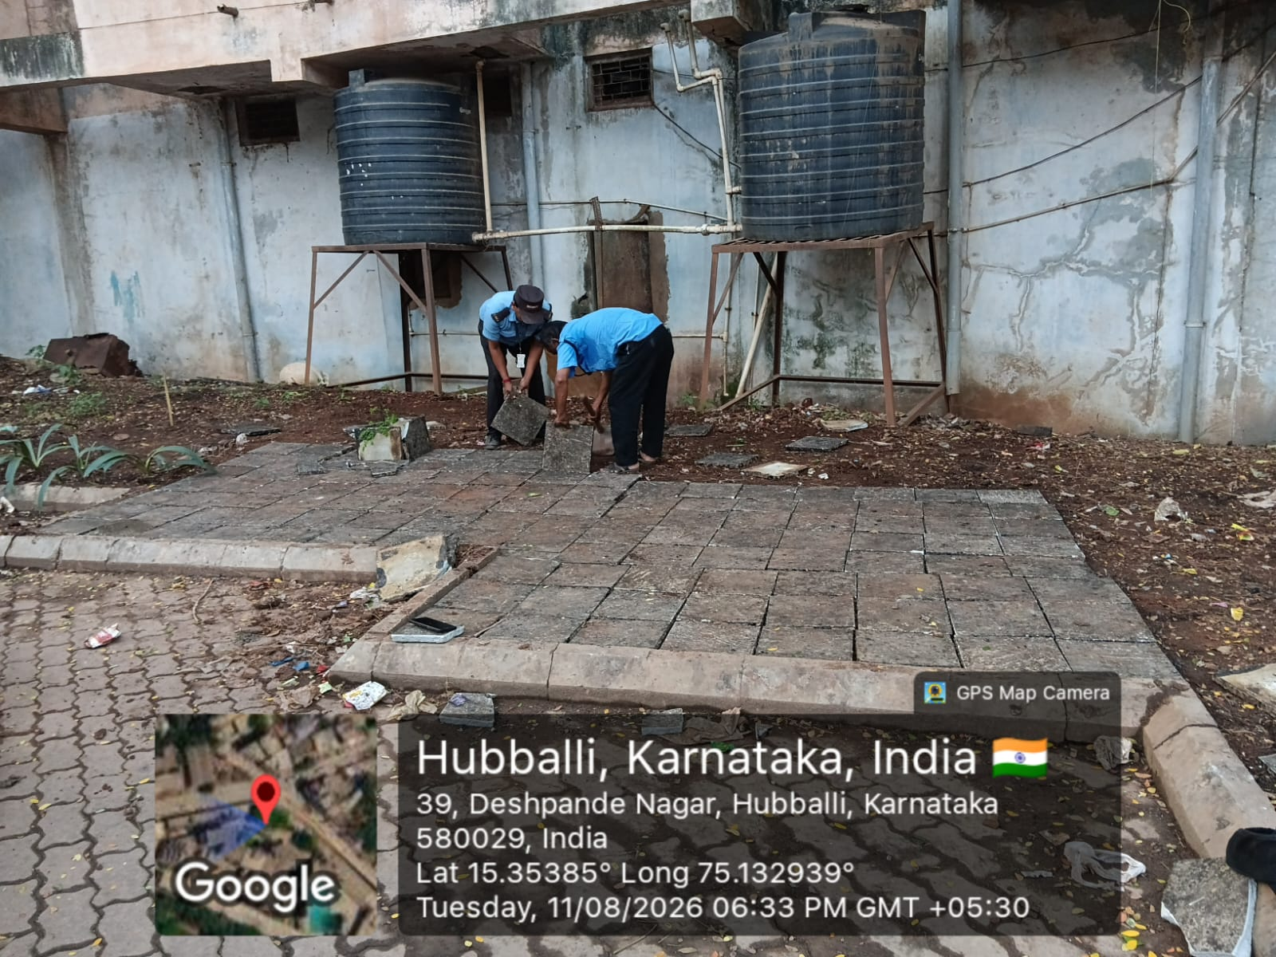
Laying of Waste Tiles in the Cleaned Area Flooring Work in Progress by Security Team

Slide 9
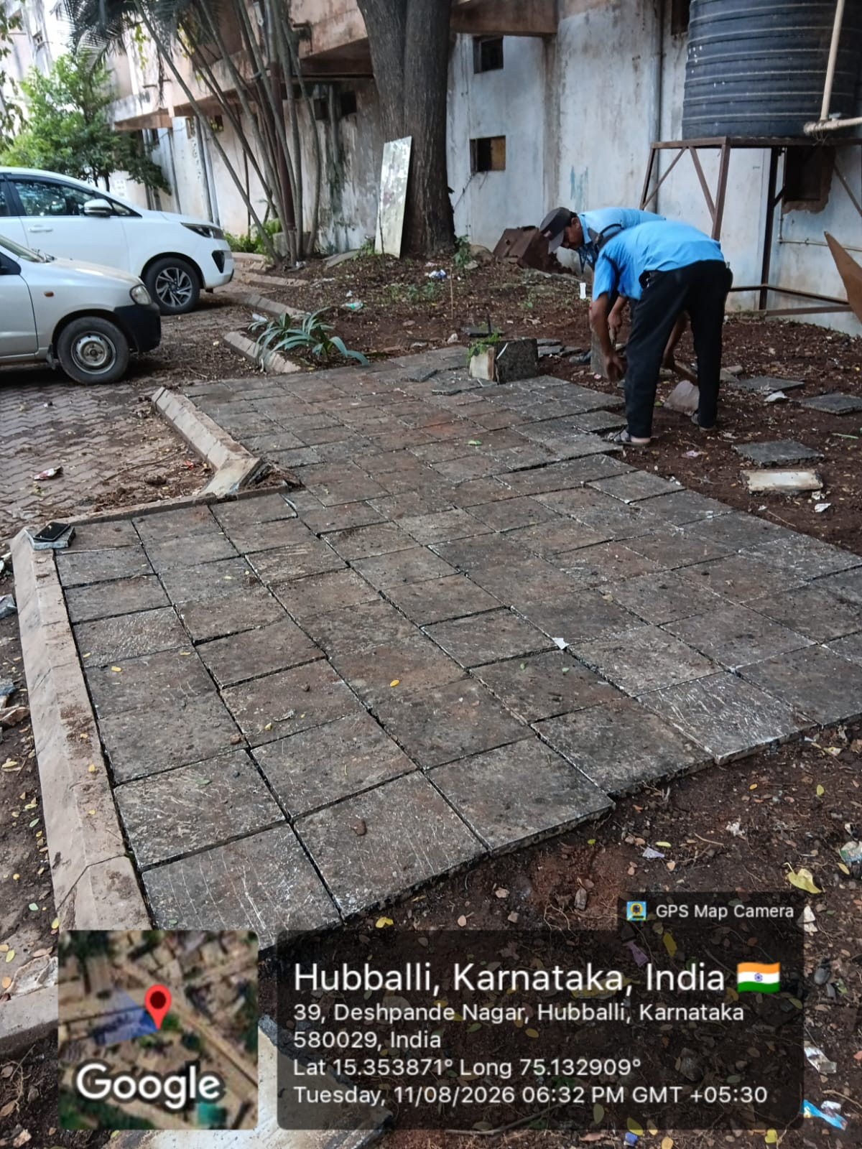
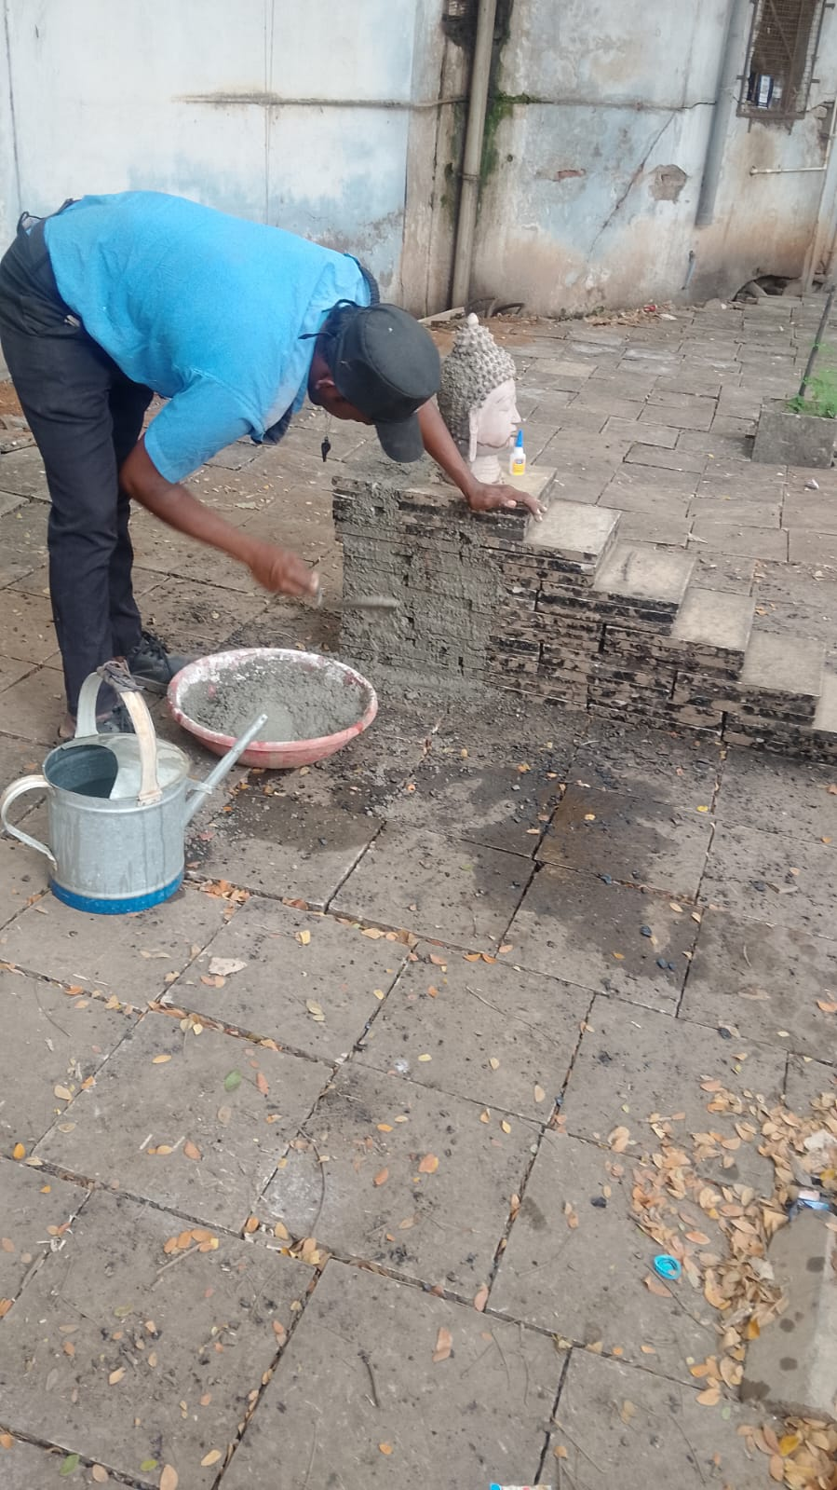
Laying of Waste Tiles in the Cleaned Area Flooring Work in Progress by Security Team

Slide 10
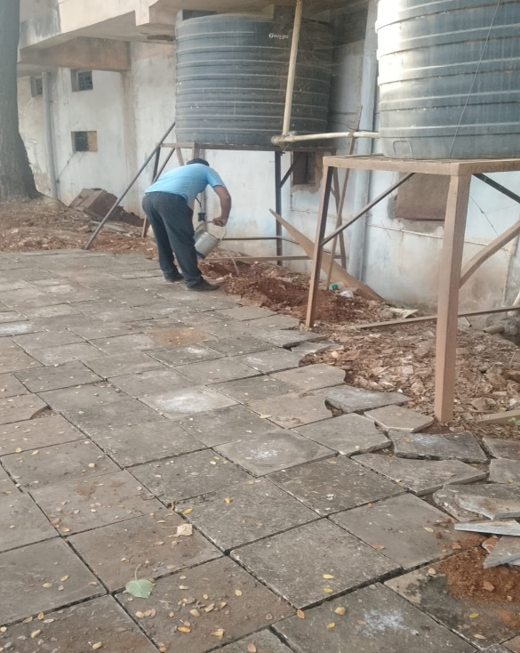
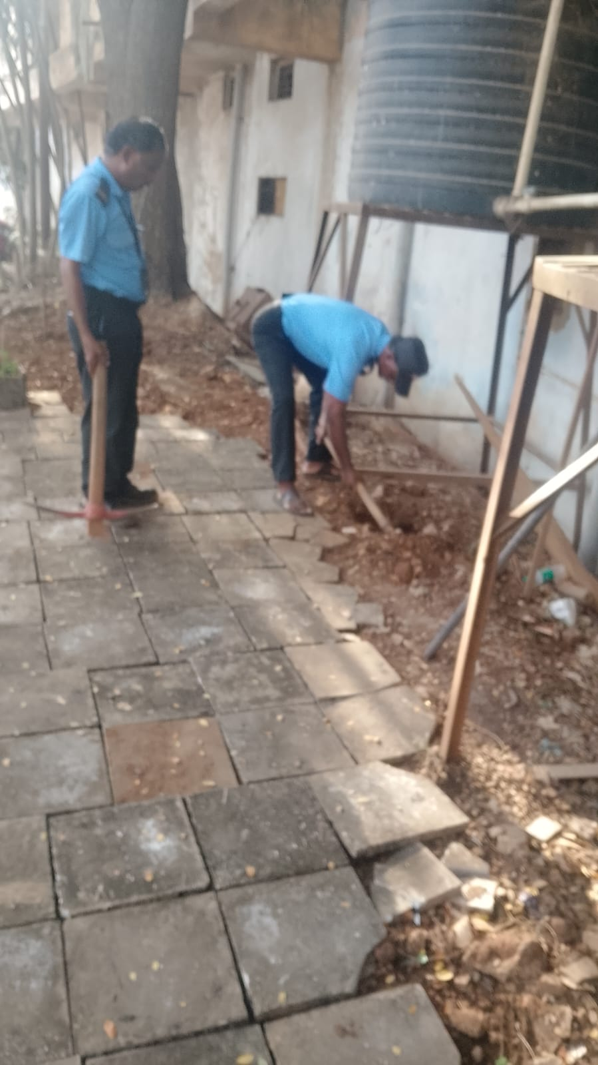
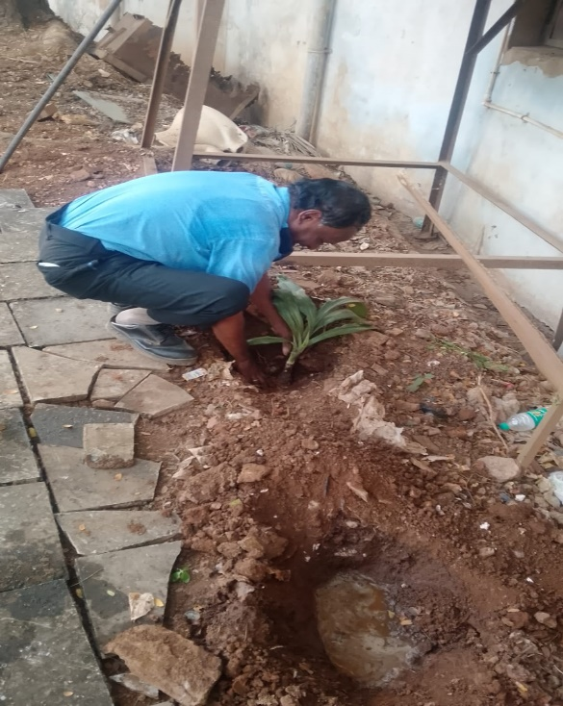
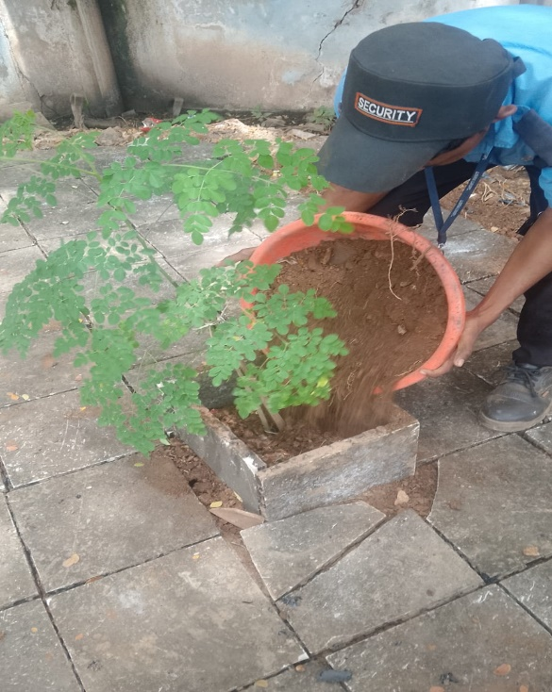
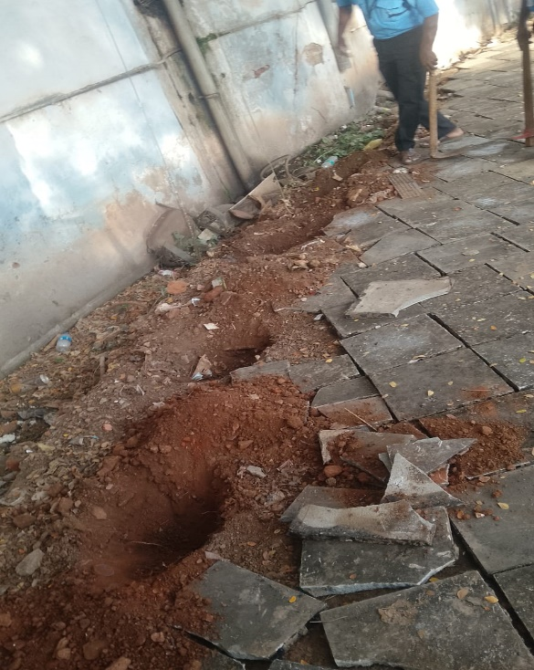
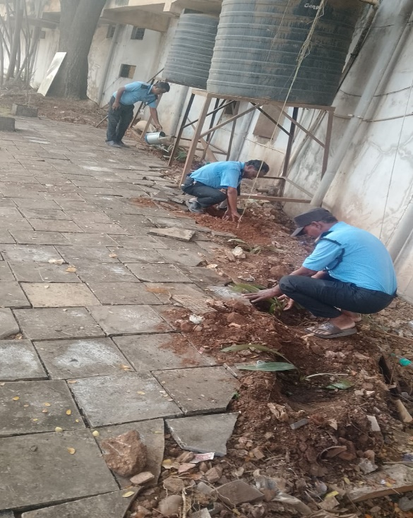
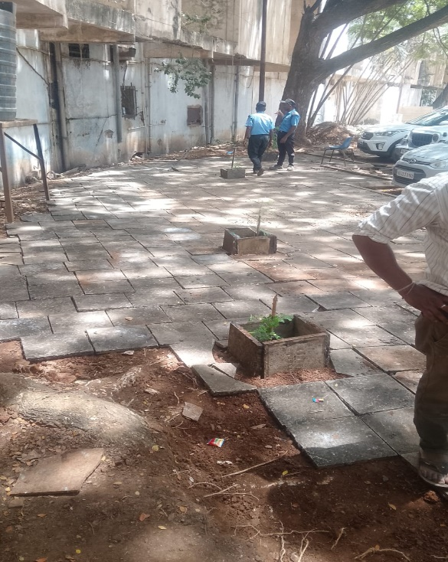
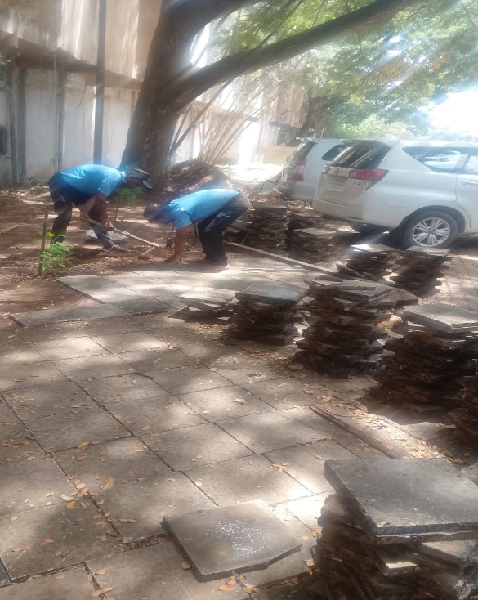

Slide 11
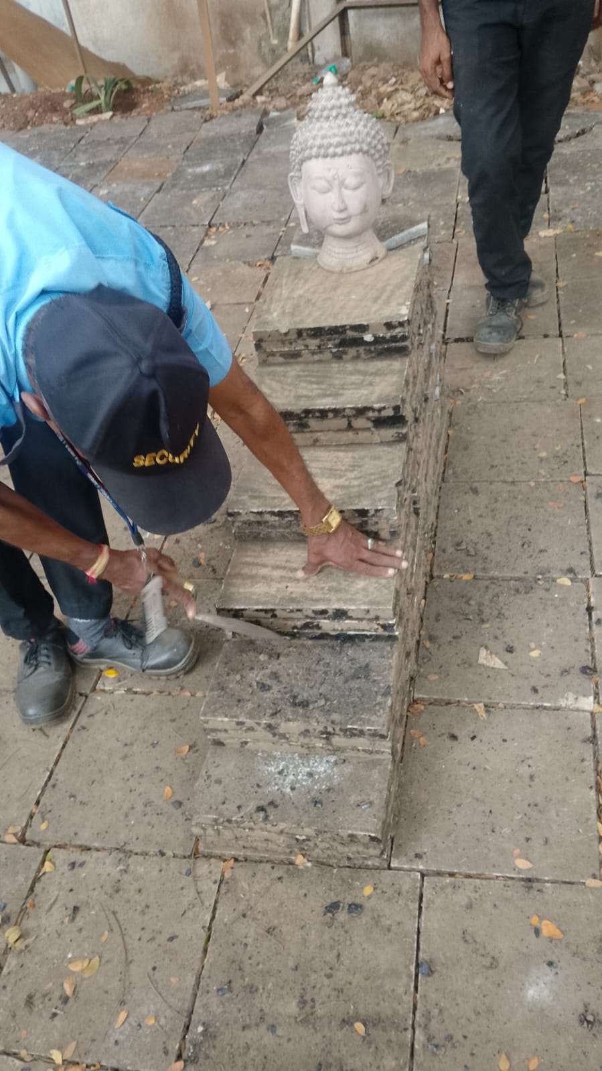
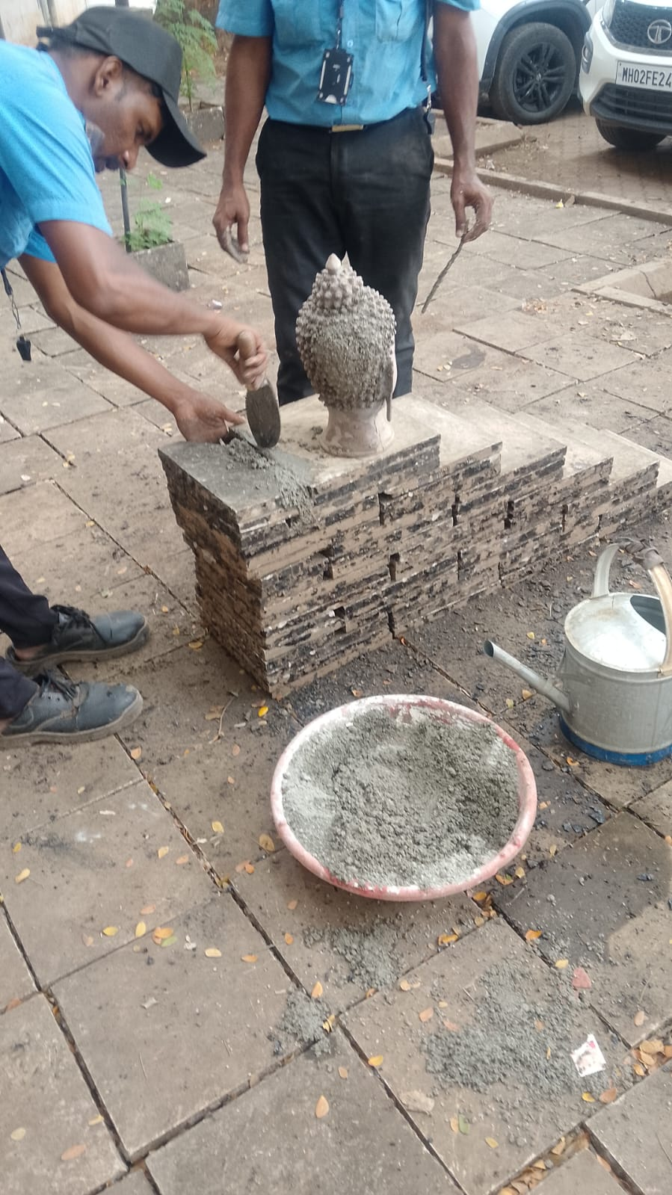
Installation of Repaired Idol to Maintain Cleanliness, After completion of tiles laying work, a broken idol was repaired
with cement and installed at the location to prevent people from dumping garbage again and to maintain sanctity & cleanliness.

Slide 12
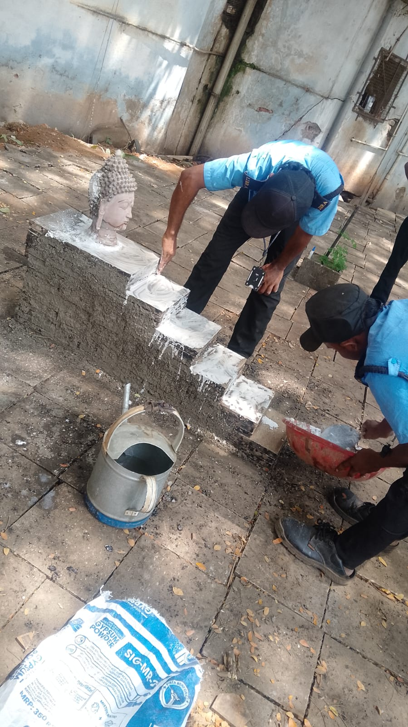
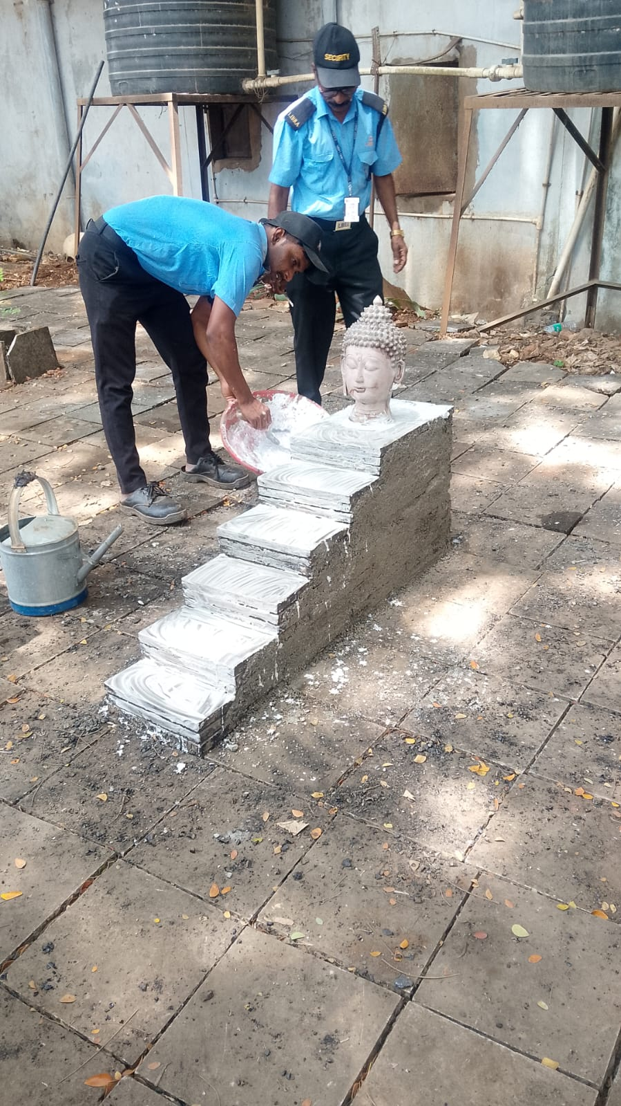
"Buddha Steps Towards Peace" - A Creative Artwork from Waste Tiles by Security Team

Slide 13
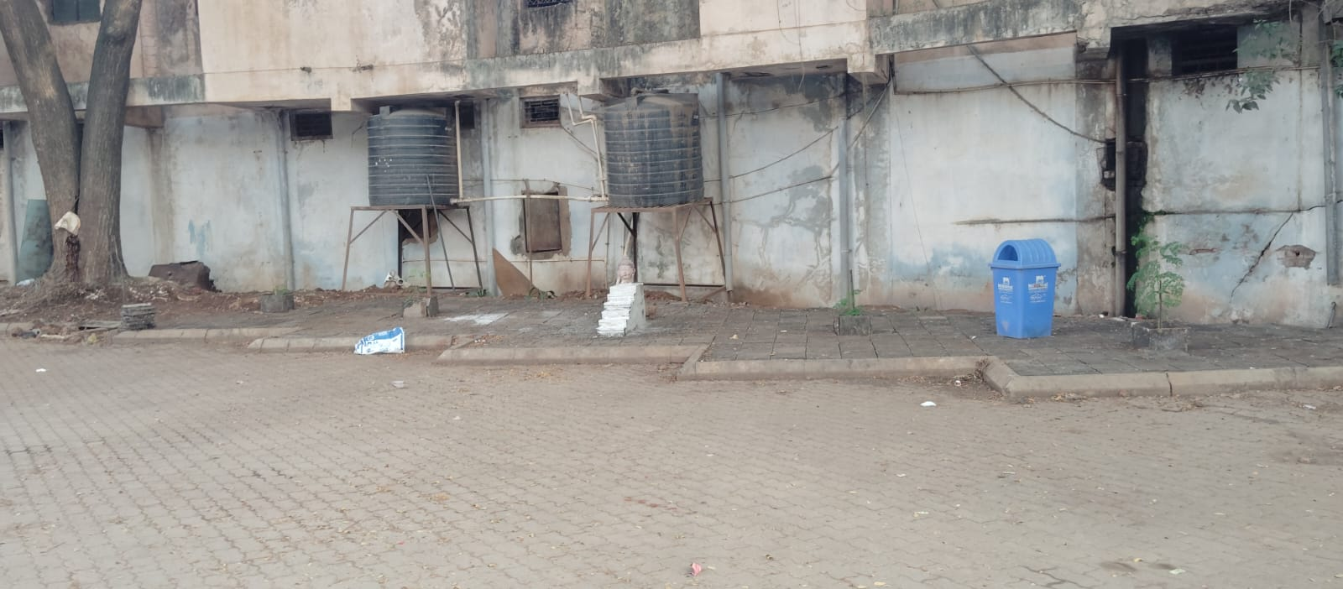
Final Outcome - A Clean & Beautiful Premises, Garbage Dumping Area Successfully Converted into
a Clean, Beautiful and Usable Space

Slide 14
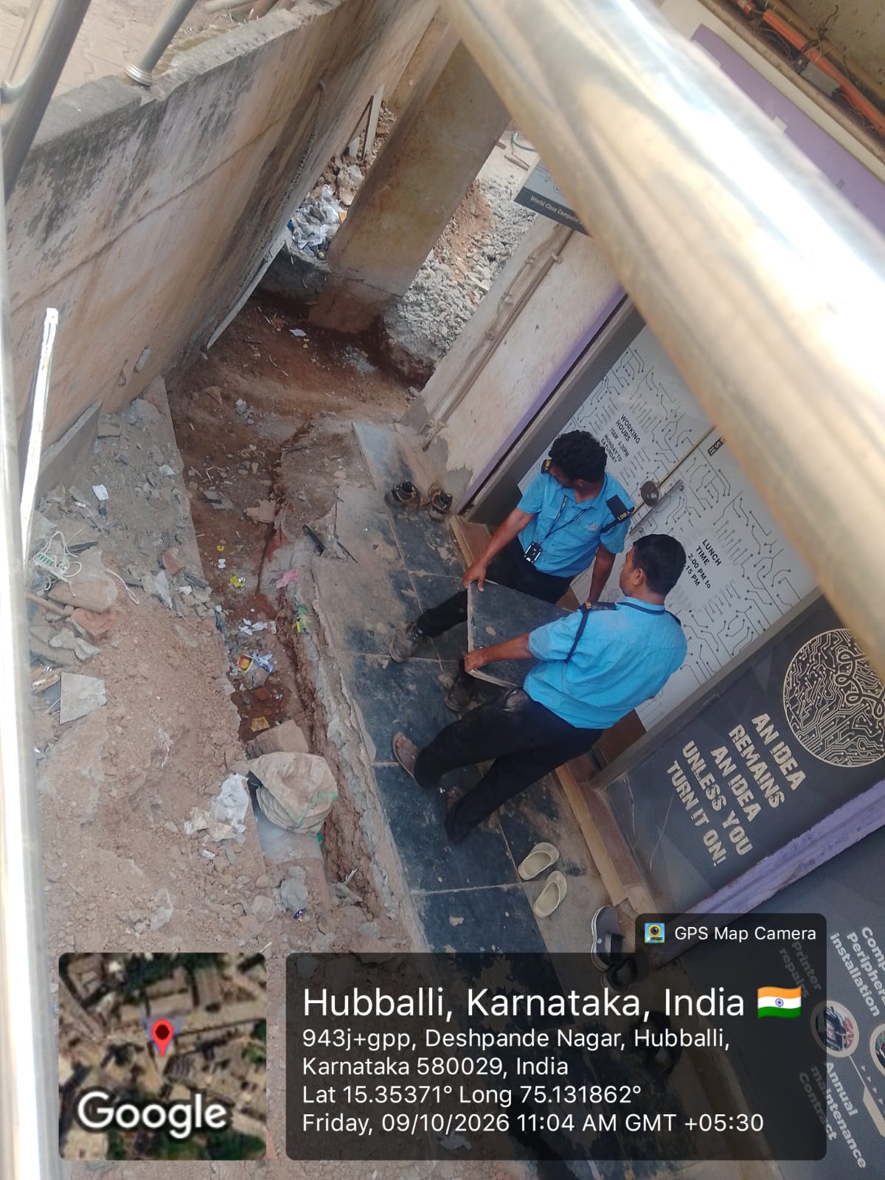
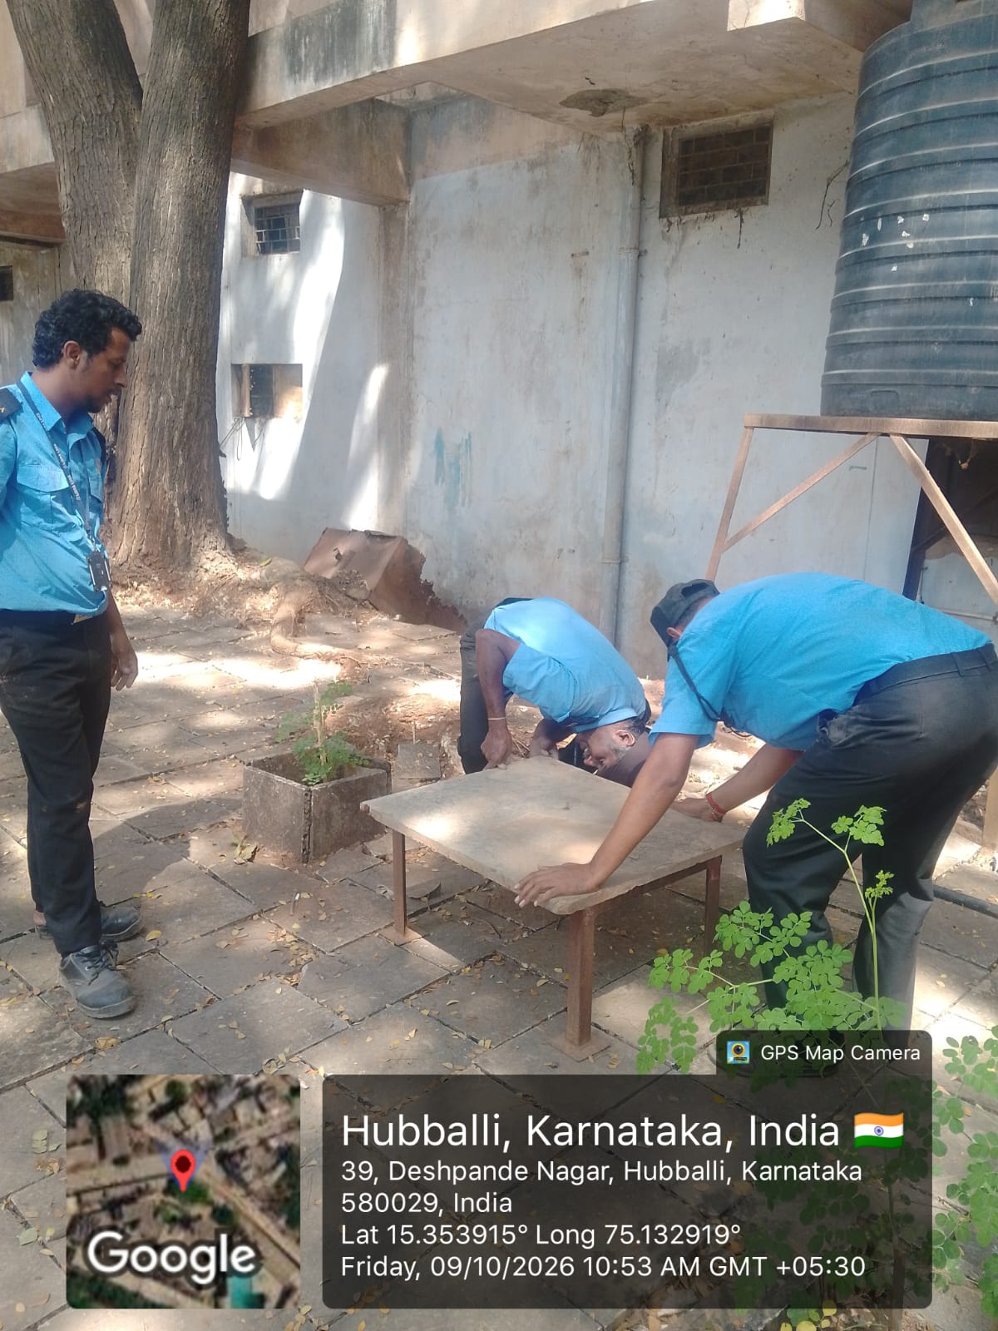
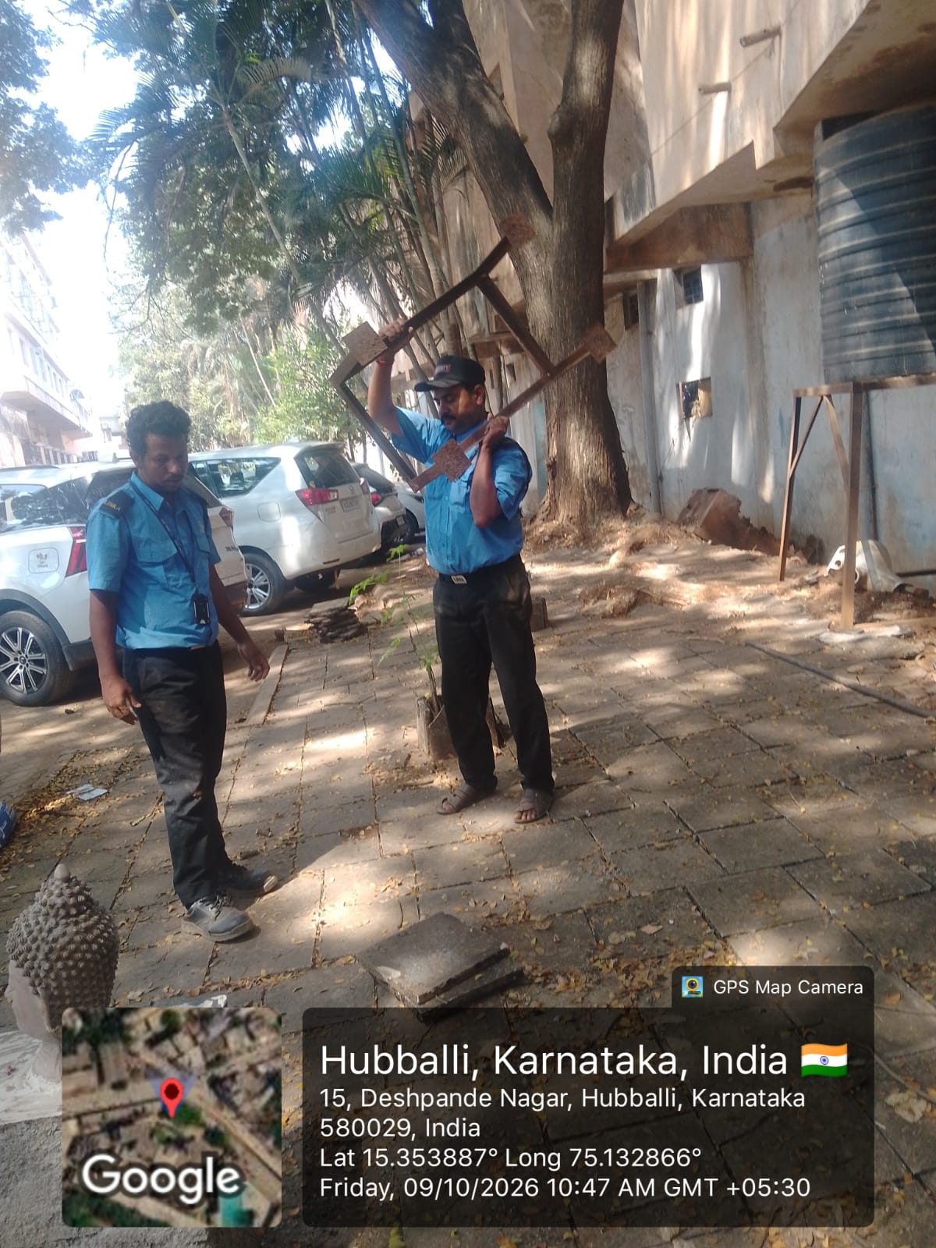
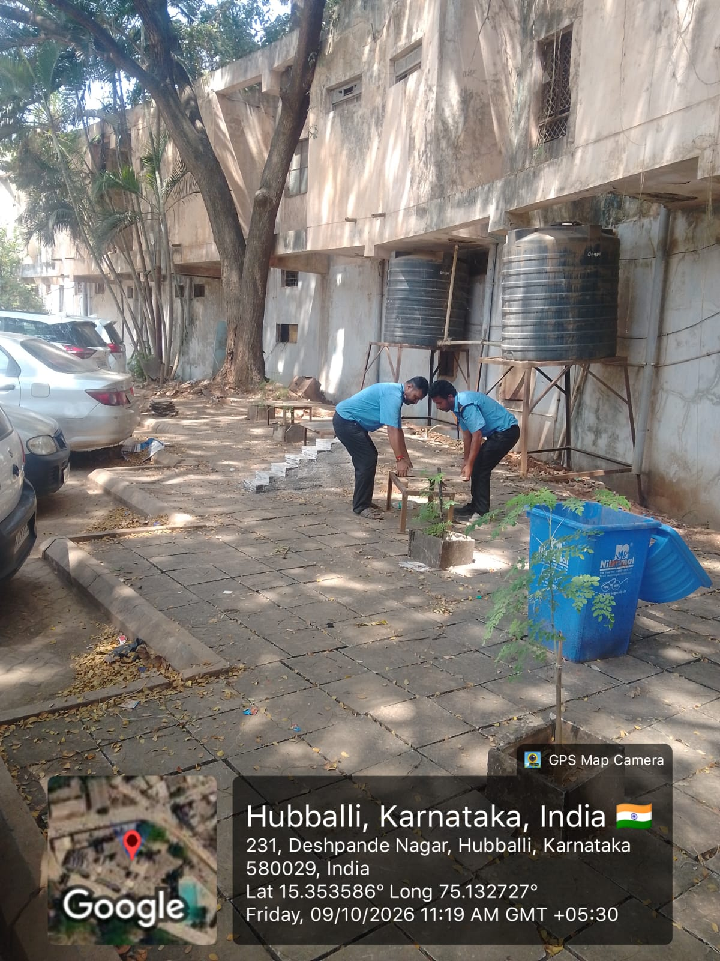
Now the area is clean and properly utilized for:- Sitting arrangement for people- Car parking facility

Slide 15
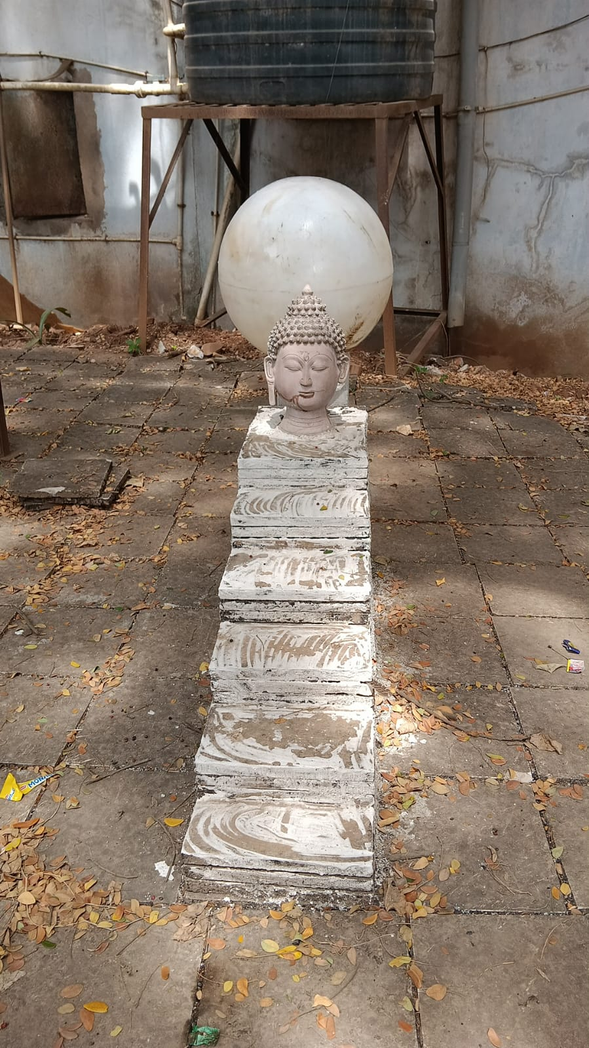
INNOVATIVE RESTORATION
Best Out of Waste
Waste broken tiles lying in the premises were collected and removed. The damaged Buddha statue was systematically repaired and re-installed. The waste tiles were creatively reused to construct beautiful steps for the fountain base. An old, unused large light globe/bulb from a discarded light pole was innovatively reused and placed behind the Buddha idol to create a divine Moon / Halo effect. A perfect example of Sustainable Creativity and Cost-Effective Restoration.

Slide 16
THANK YOU FOR WATCHING

